Slide 1

Bugs
Bc. Agáta Pavlíková
Bc. Marek Rucki
5ZIS12
Notes:
Marek

Slide 2

What will we talk about?
What is a bug?
Bug types in software development
Debugger
Fails, Bug Prevention and Detection
Activity
Notes:
Agátka

Slide 3
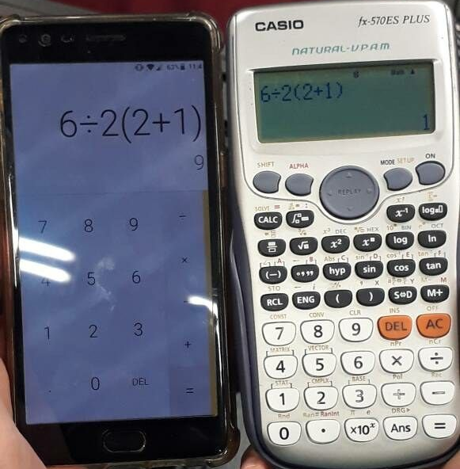
What is a Bug?
A deviation from the expected behavior of a program.
Can cause incorrect results, application failure, security vulnerabilities.
Example: A calculator that incorrectly adds two numbers.
Notes:
Marek

Slide 4
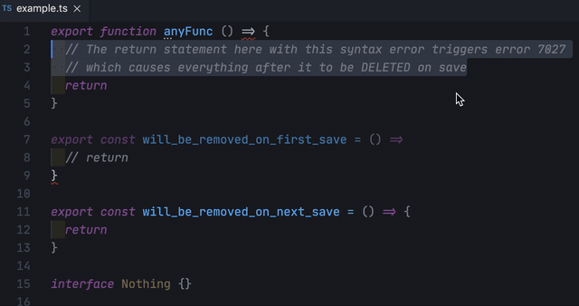
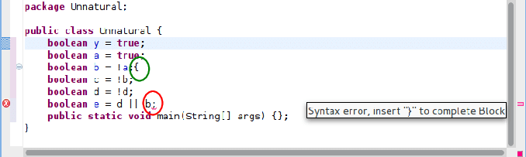
Bug Types in Software Testing
Security Bugs
Syntax Bugs
Notes:
Agátka

Slide 5
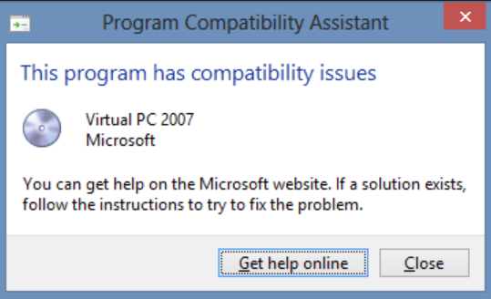
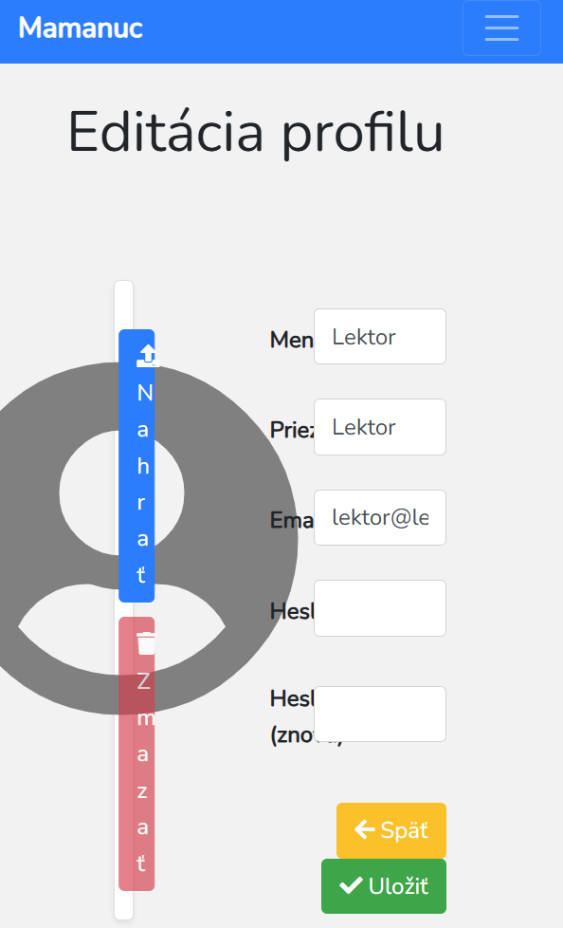

Bug Types in Software Testing
Compatibility Bugs
Performance Bugs
Notes:
Agátka

Slide 6
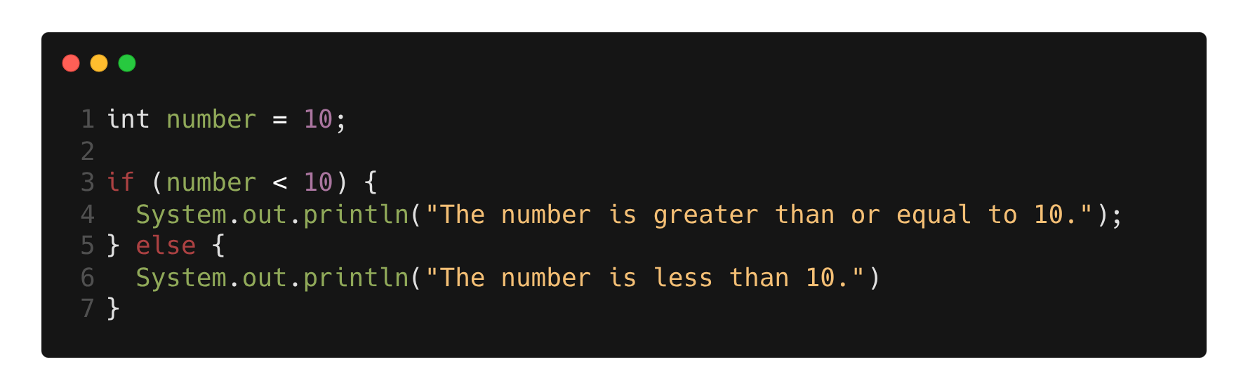
Logical Error
Wrong condition
Notes:
Marek

Slide 7
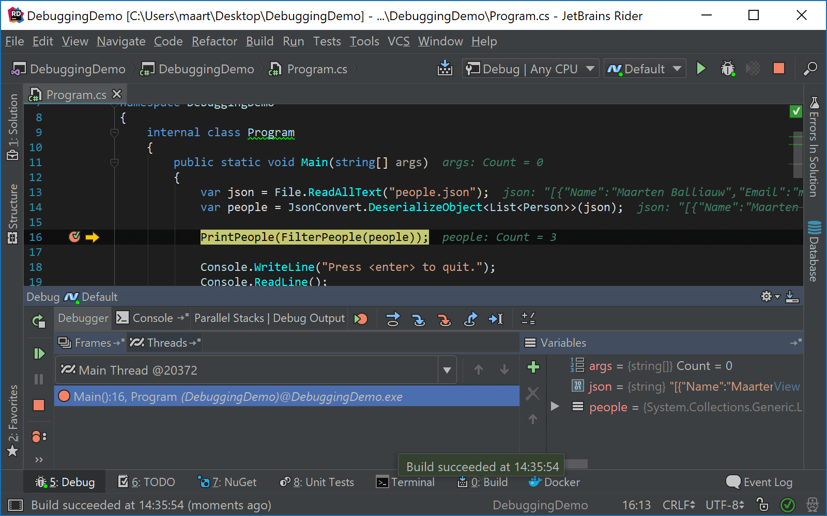
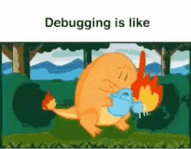
Debugger
Definition of a Debugger
How a Debugger Works
Notes:
Agátka

Slide 8
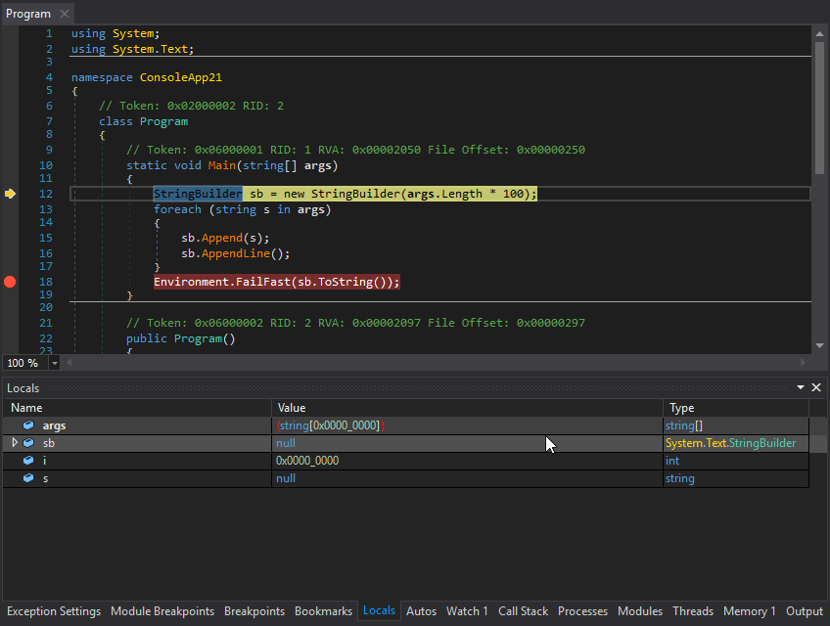
Debugger
Breakpoints and Step-by-Step Execution
Common Debugging Techniques
Benefits of Using a Debugger
Notes:
Agátka

Slide 9



Fails
Knight Capital (2012)
$440M loss in 45 min
Cause: Software deployment bug
Result: Uncontrolled stock purchases, near bankruptcy
Notes:
Marek

Slide 10
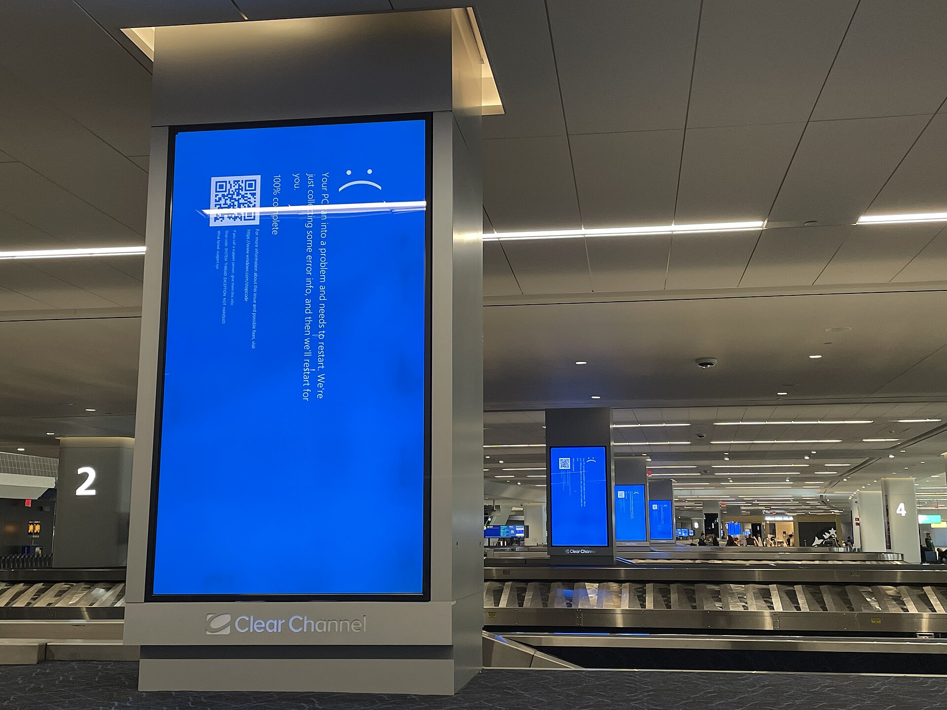


Fails
CrowdStrike Outage (July 2024)
Cause: Bad Falcon Sensor update from CrowdStrike
8.5 Million Windows machines crashed
$10 Billion in damages
Notes:
Marek

Slide 11
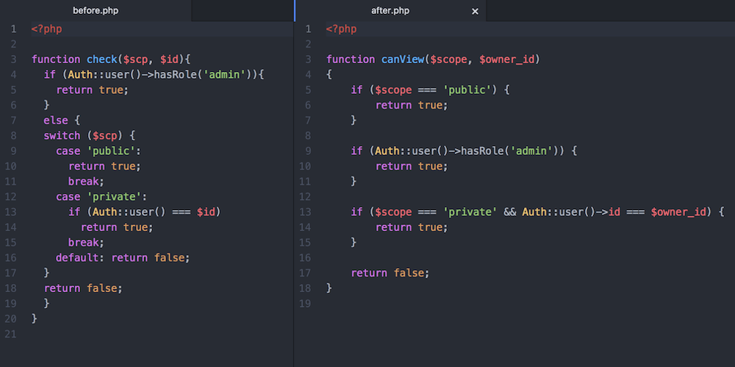
Bug Prevention
Write Clean and Readable Code
Follow Coding Standards and Best Practices
Notes:
Agátka

Slide 12
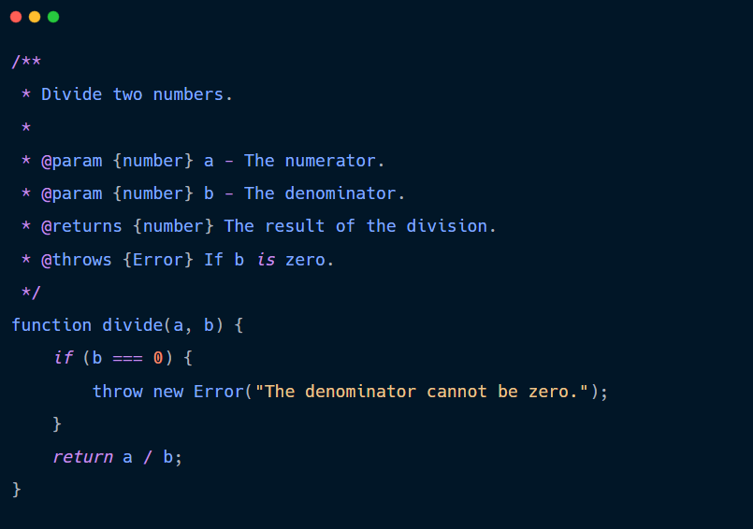
Bug Prevention
Test Edge Cases and Unusual Scenarios
Use Proper Code Comments and Documentation
Keep Dependencies and Libraries Updated
Debug Step-by-Step Instead of Guessing
Implement Unit and Integration Testing
Notes:
Agátka

Slide 13
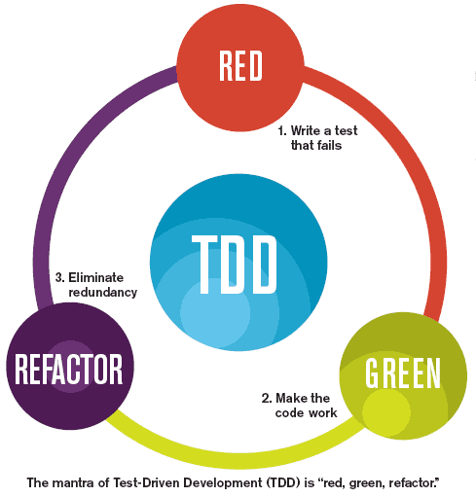
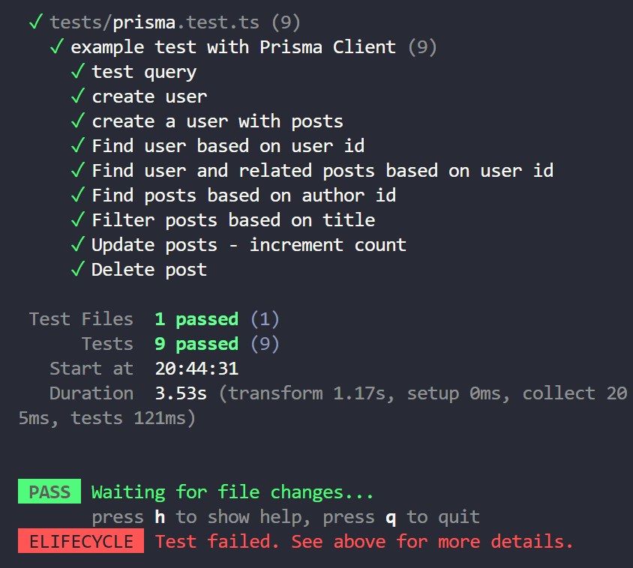
Test Driven Development
Notes:
Marek

Slide 14
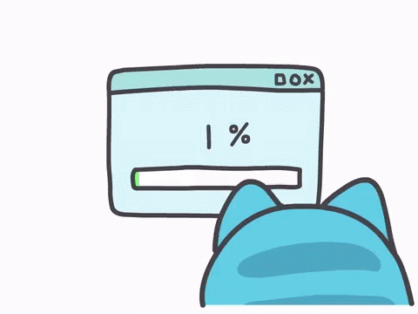
Activity: Bug Hunt
Notes:
Marek

Slide 15
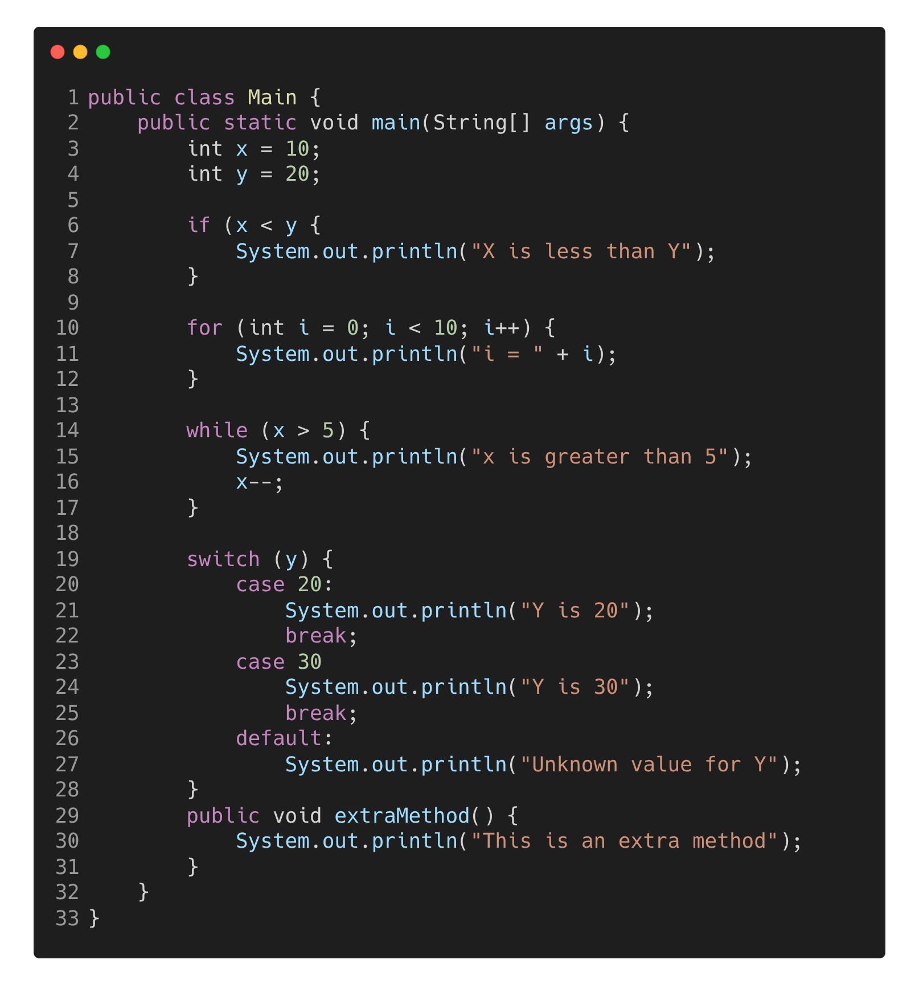
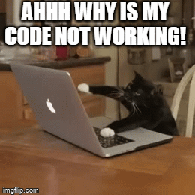
How many syntax bugs can you find?
Notes:
Agátka

Slide 16
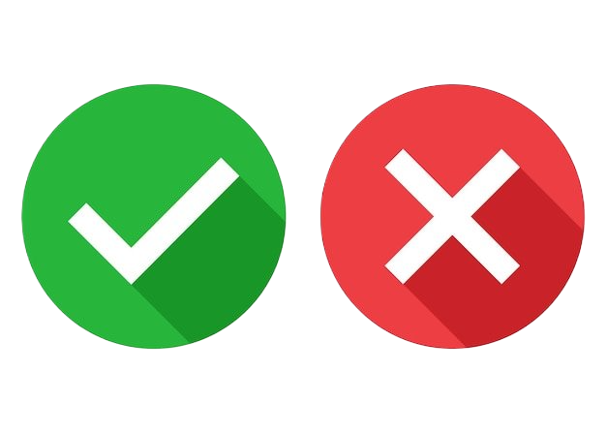
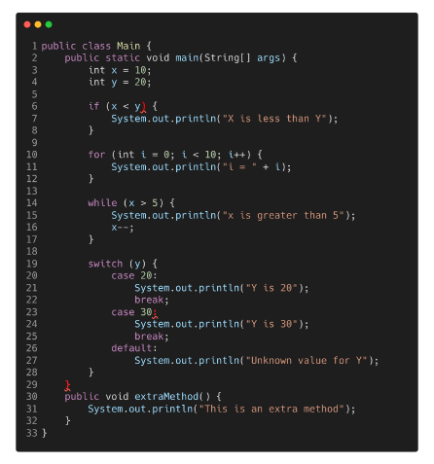
Notes:
Agátka

Slide 17
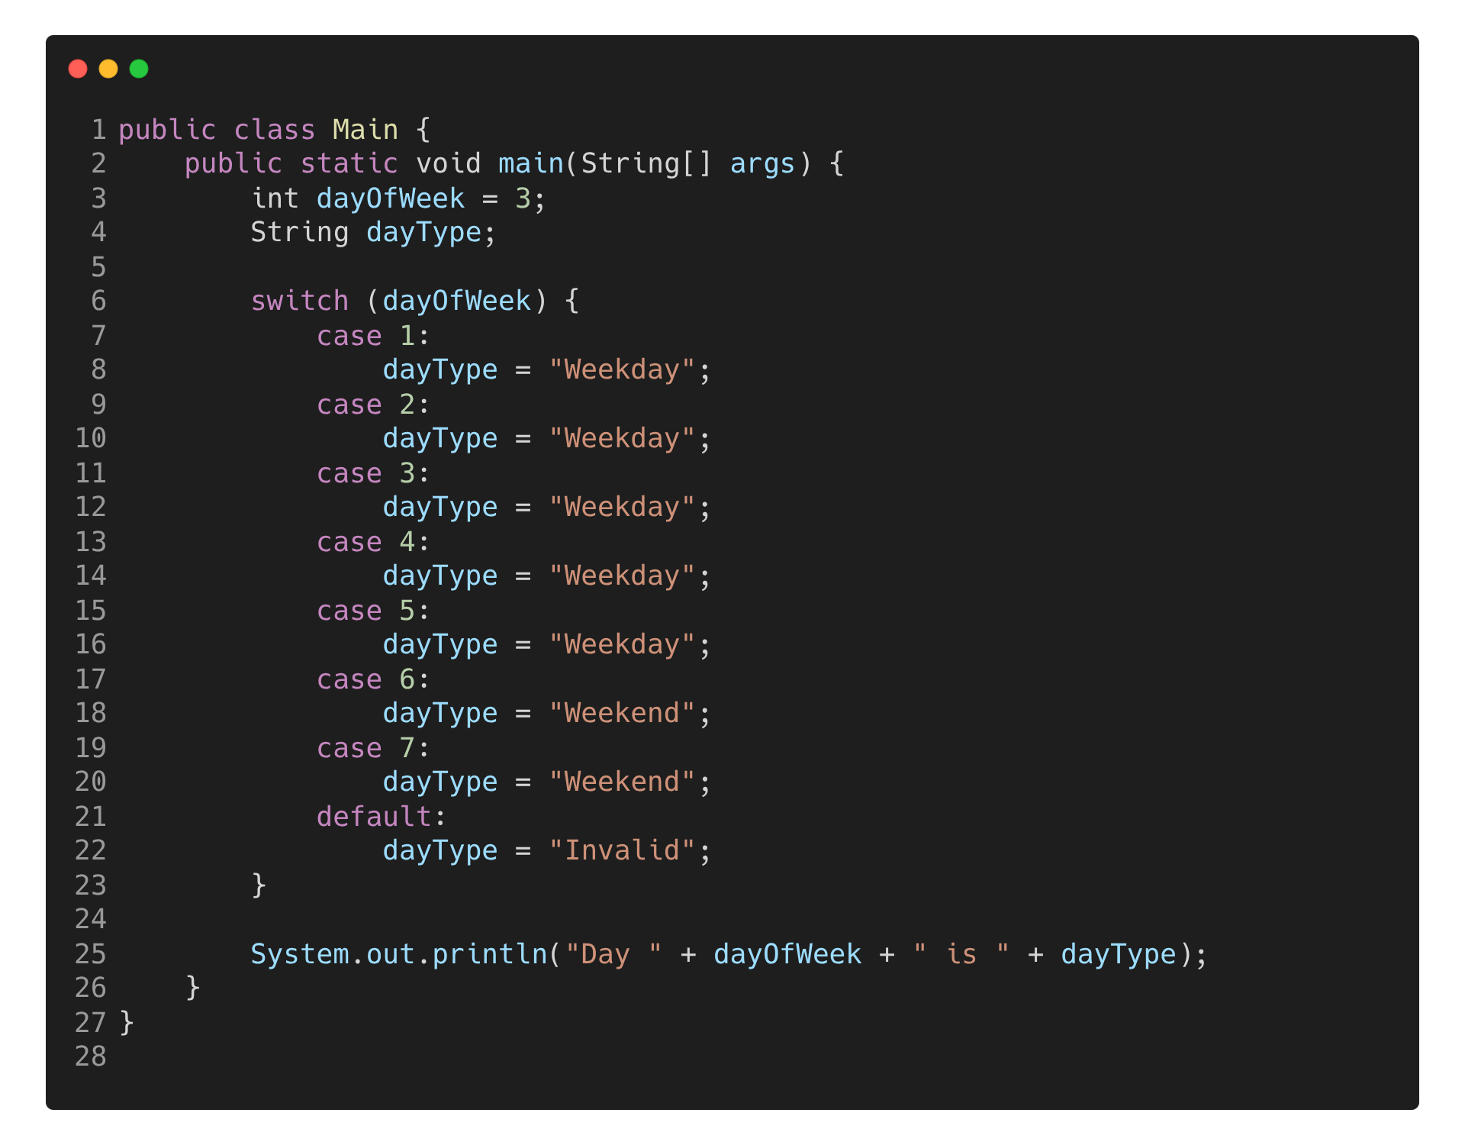
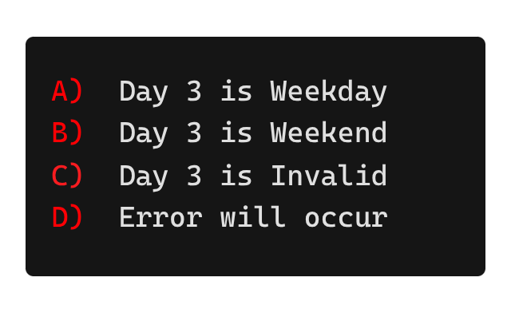

What would be the output?
Notes:
Marek

Slide 18
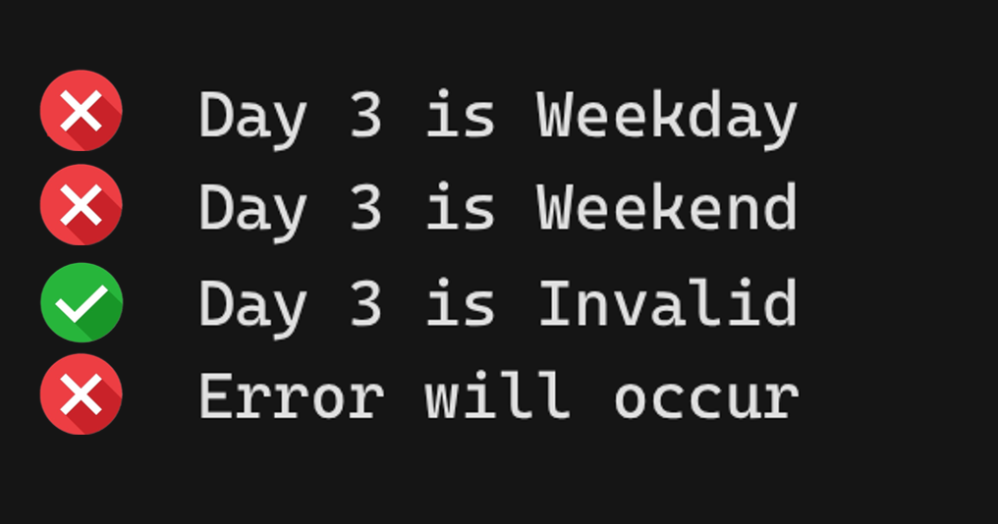
break; !!!
Notes:
Marek

Slide 19
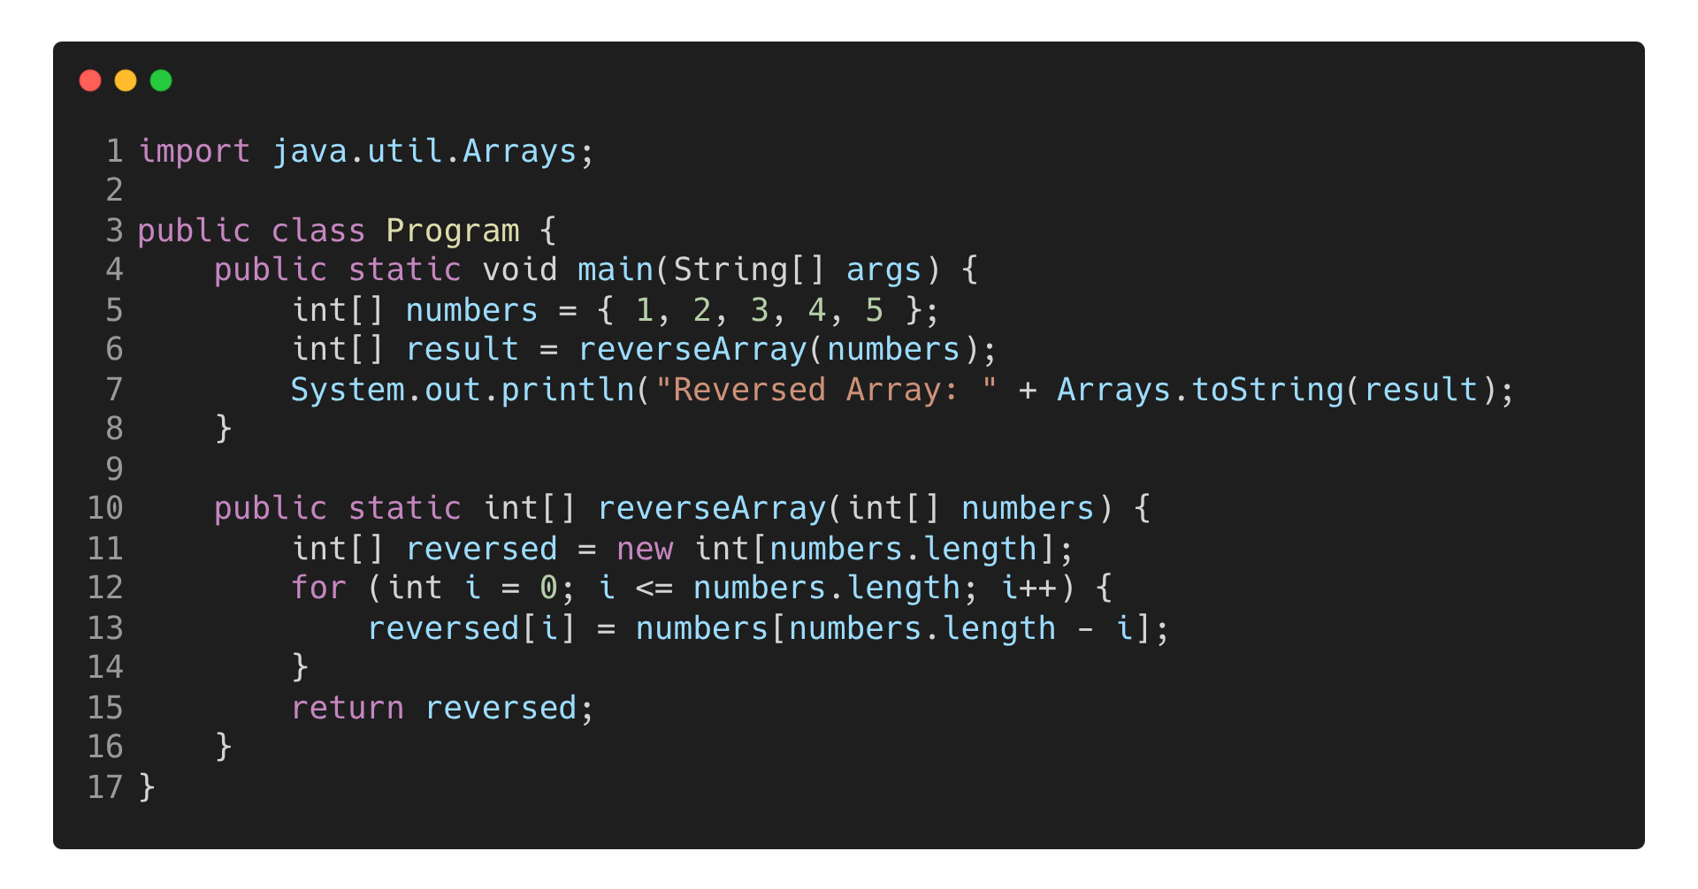
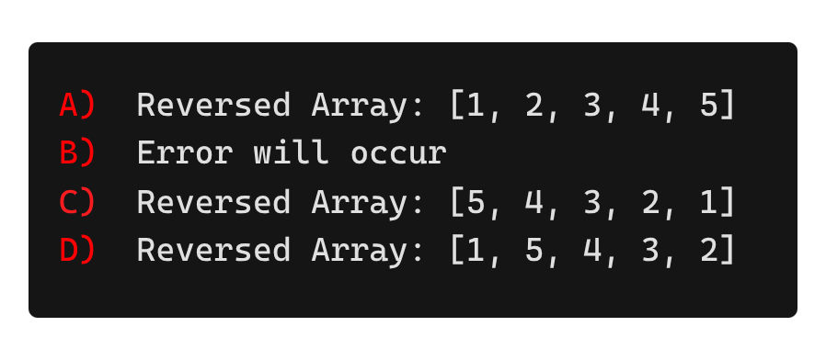
Notes:
Agátka

Slide 20
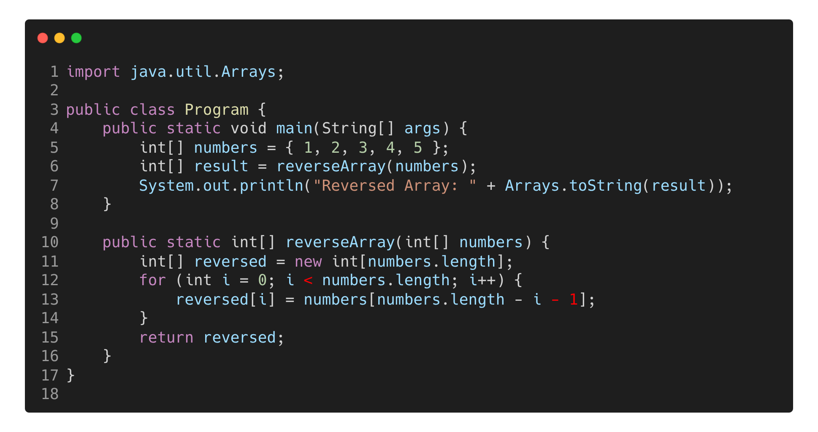
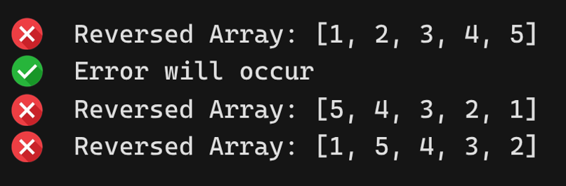
Notes:
Agátka

Slide 21
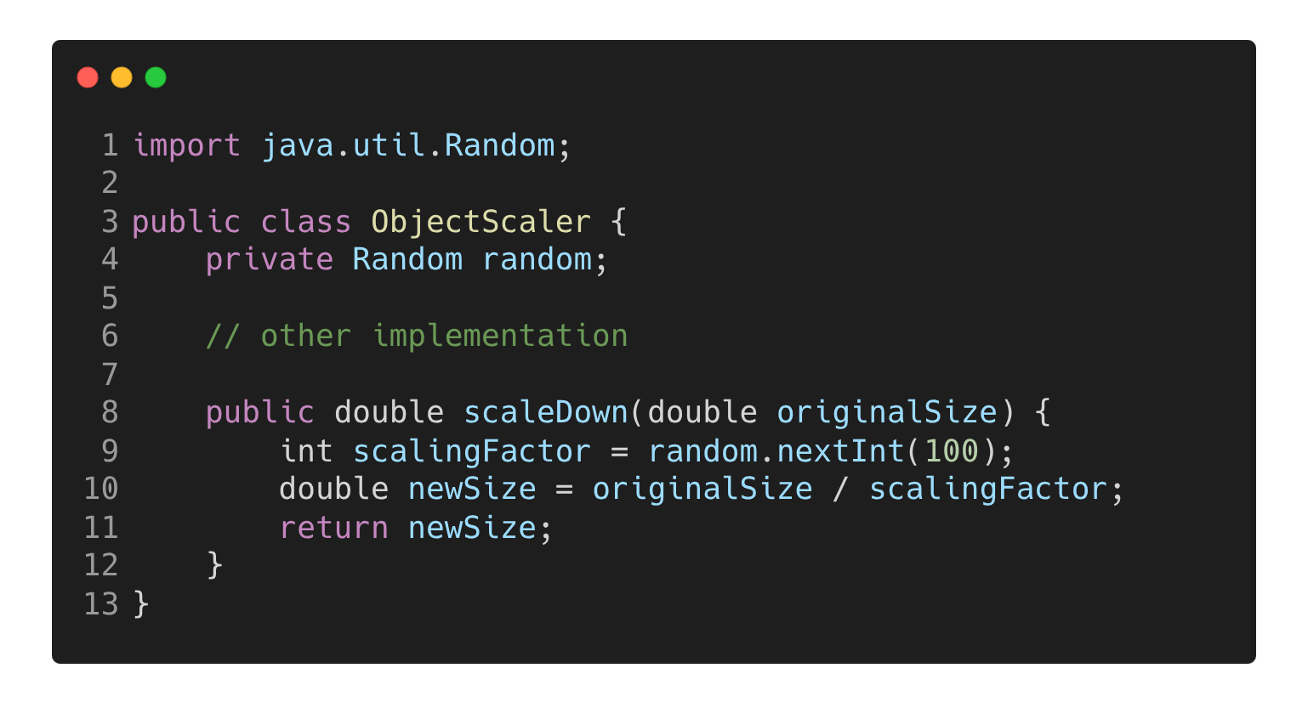
Can you find the logical error?
Notes:
Marek

Slide 22
Possible division be zero
Notes:
Marek

Slide 23
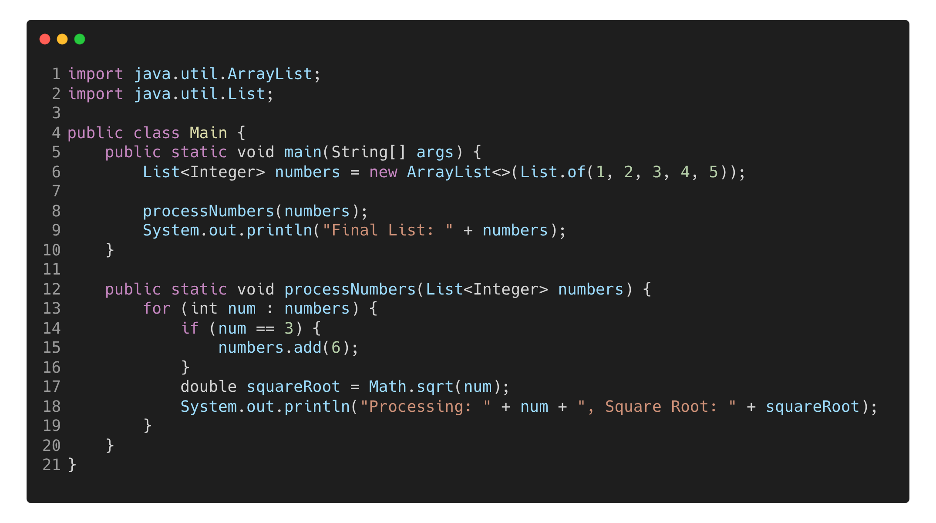
Notes:
Agátka

Slide 24
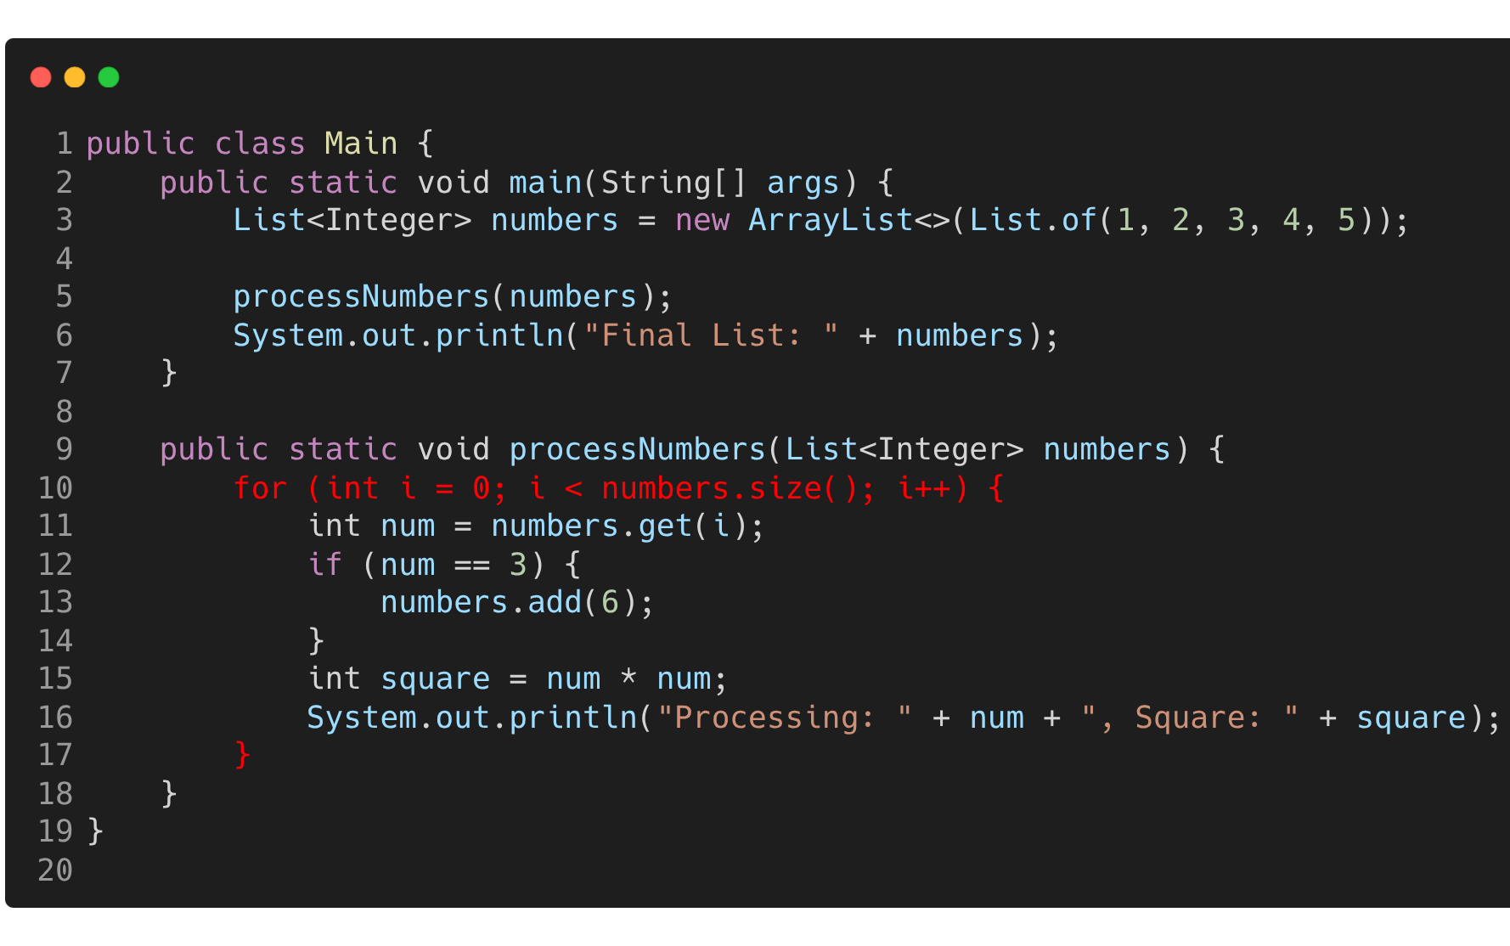

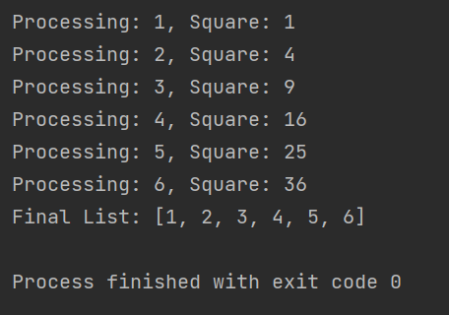
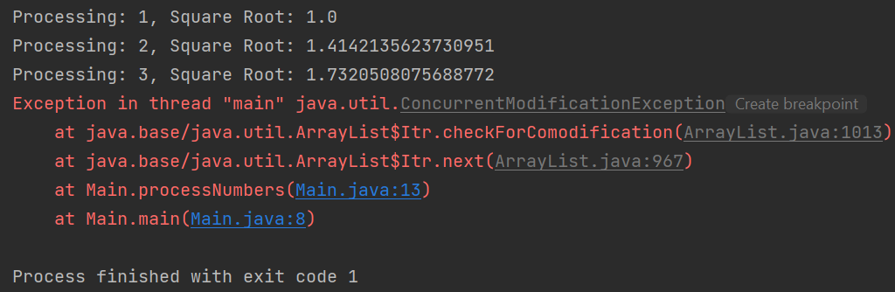
Notes:
Agátka

Slide 25
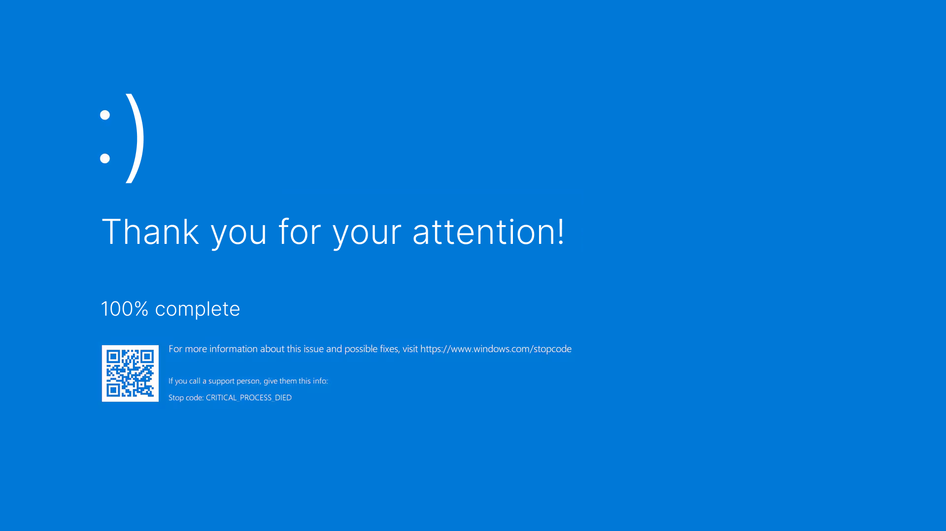

Slide 26
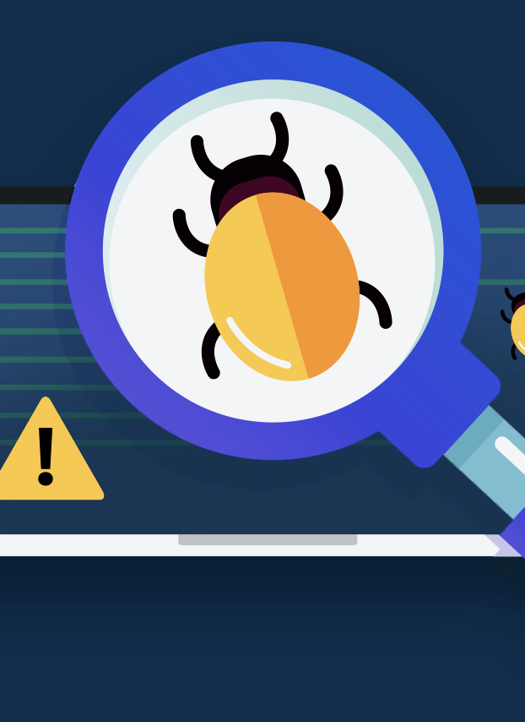
Sources
Google Images
https://www.accelq.com/blog/types-of-software-bugs/
https://learn.microsoft.com/en-us/visualstudio/debugger/debugging-absolute-beginners?view=vs-2022&tabs=csharp
https://testgrid.io/blog/bug-prevention-in-software/
https://www.henricodolfing.com/2019/06/project-failure-case-study-knight-capital.html
https://en.wikipedia.org/wiki/2024_CrowdStrike-related_IT_outages

